Slide 1
Assignment 2 Longitudinal Data Analysis
Stefan Velev - r0924289
Adhithya Unni Narayanan - r0776057

Slide 2
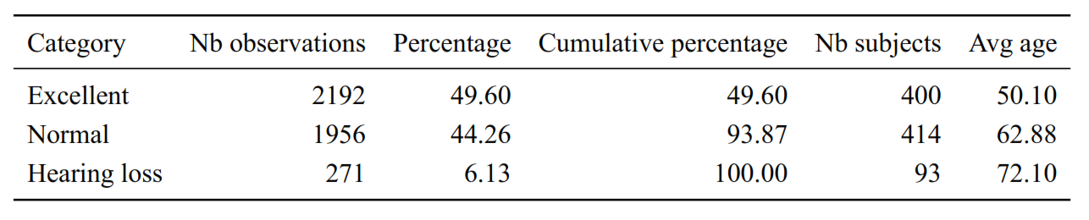
Data Trichotomization
We use existing medical literature and in congruence with the median to choose suitable cut of points.
Hearing Loss : y > 25dB
according to existing medical literature Clark (1981)
Normal hearing : 6dB < y ≤ 25dB
6dB is median value for all observations ≤ 25dB
Excellent hearing : y ≤ 6dB

Slide 3
Marginal and Mixed Models
Marginal model
Mixed Model
Generalized Estimating Equation
GEE
Gives population averaged effects (Marginal Probabilities)
Variate selection based on a greedy approach with Wald test
Variates: Age, Time, Age*Time, Age^2 and a learning effect
Cumulative Link Mixed Model
CLMM
Only with random intercept
Gives subject specific effects (Conditional Probabilities)
Variate selection based on a greedy approach and AIC
Variates: Age, Time, Age*Time, Age^2 and a learning effect

Slide 4
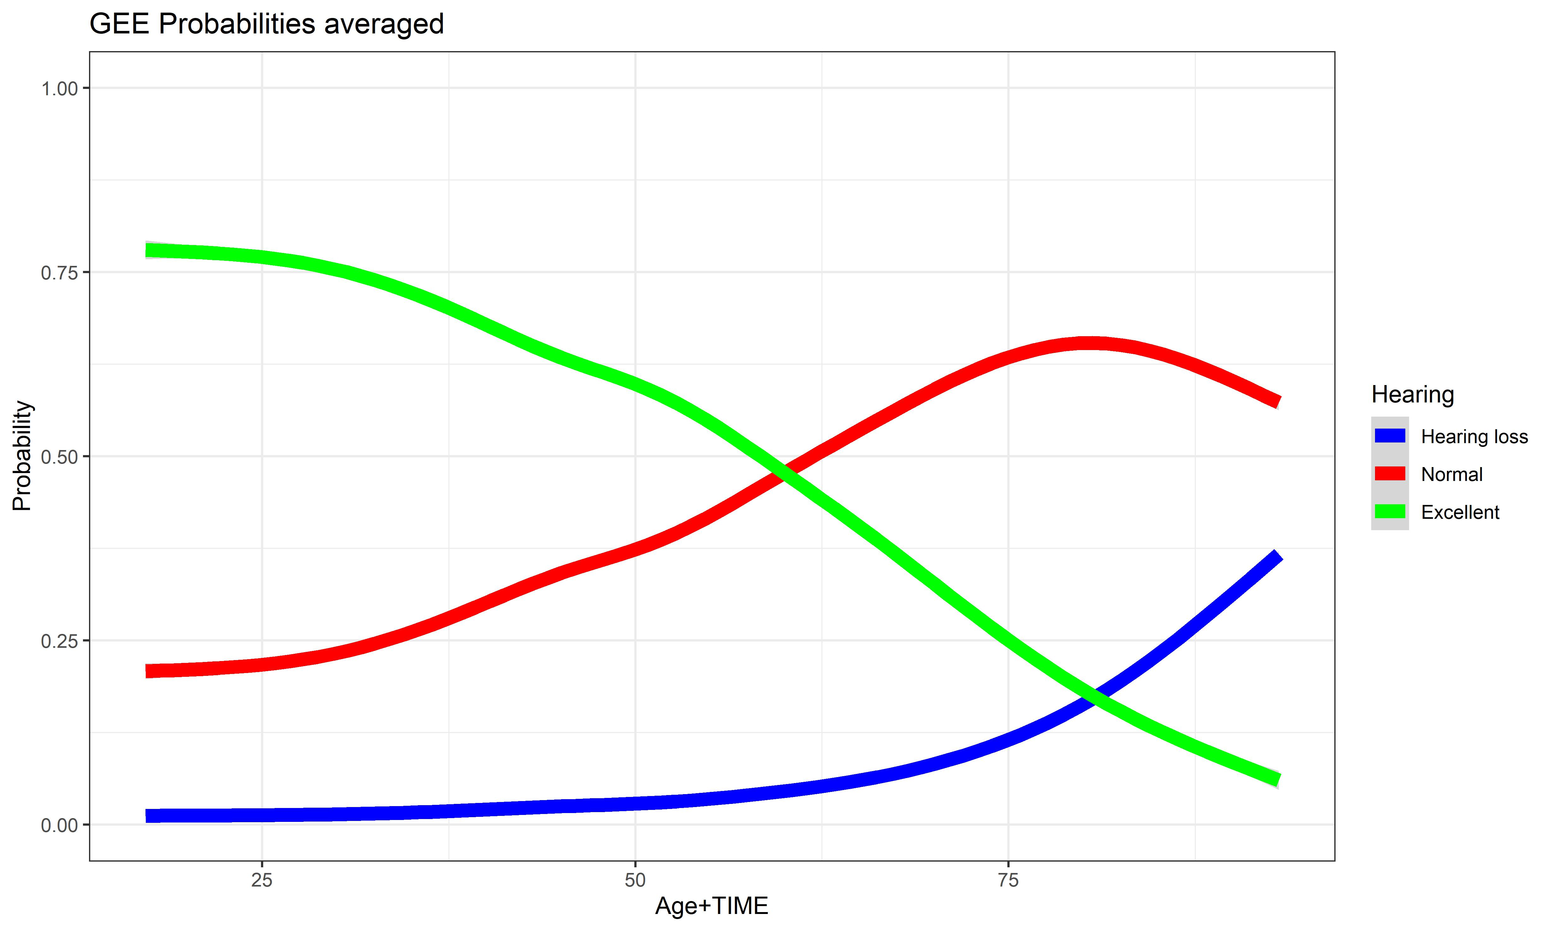
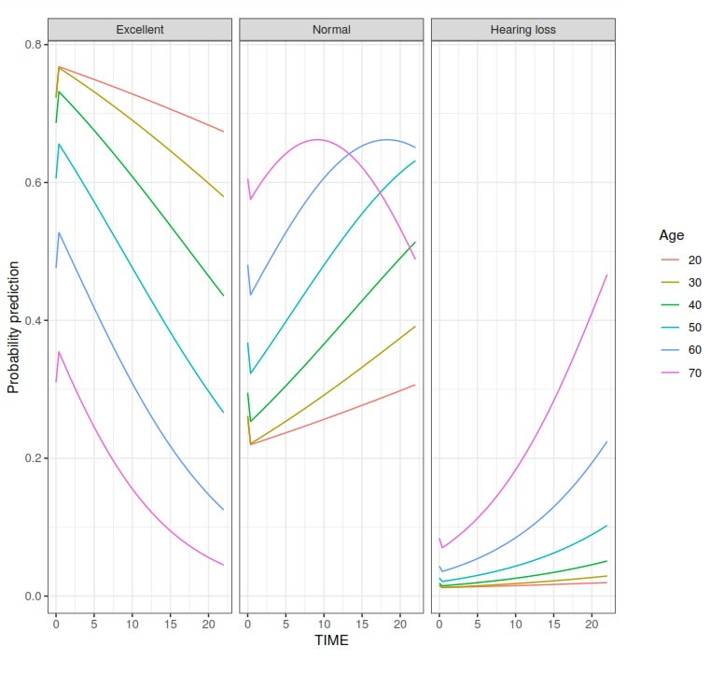
Marginal Effects model

Slide 5
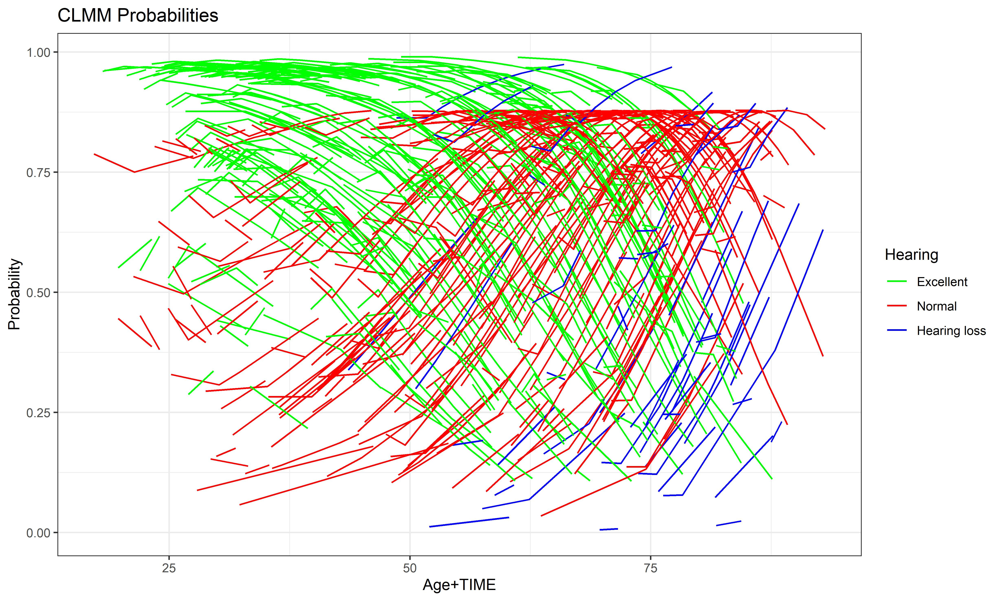
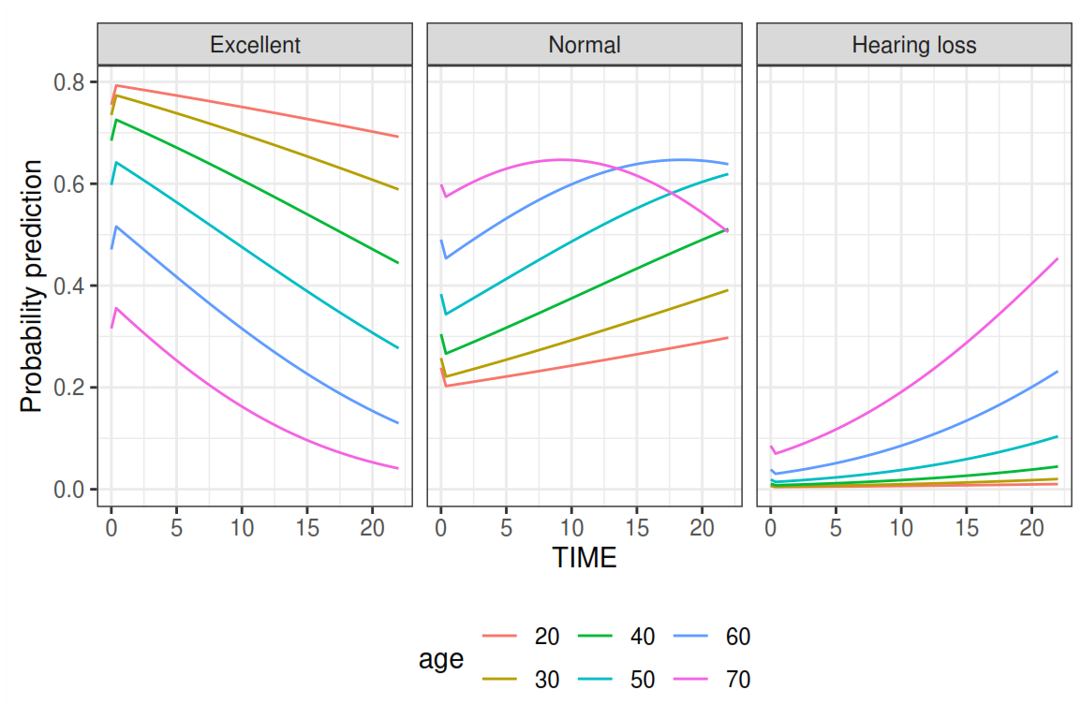
Mixed Effect
To infer the marginal evolution of hearing loss over time, we cannot simply set the random intercept equal to zero to calculate the prediction. This is because the expectation of a logit function is not equal to the logit of the expectation. We need to integrate the GLMM

